Slide 1
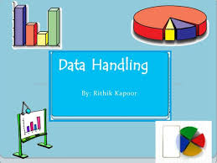
DATA HANDLING

Slide 2
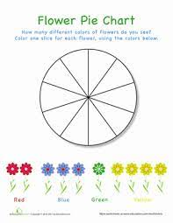
COLLECT AND SORT OBJECTS

Slide 3
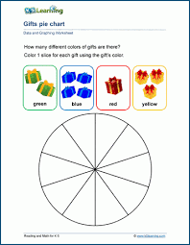

Slide 4
Reference

